Slide 1


Innovative organic fertilisation adapted to precision farming – GRANOFARM
Handbook
Edited by Tamás Szolnoky
VP3-16.1.1-4.1.5-4.2.1-4.2.2-8.1.1-8.2.1-8.3.1-8.5.1-8.5.2-8.6.1-17
Project identification number: 1924493826
December 31, 2023

Slide 2



GRANOFARM EIP AGRI Group
Agrogeo coordinates an innovation project; identification number: 1924493826, called Innovative organic fertilisation adapted to precision farming: 2019-2023.
The consortium has developed an innovative procedure to improve precision application and efficiency of organic and organo-mineral fertilizers using organic coating components are allowed in organic farming.
GRANOFARM innovation operative group includes: Agrogeo Ltd. (consortium leader), Ferenc László Kósa accredited agricultural consultant, Hungarian University of Agriculture and Life Sciences, Szabolcs János, Czakó, Kalmár Ferenc, Márk Sági farmers.
This invention aims to improve durability and plant nutrition efficiency of pelleted and granulated organic, organo-mineral fertilizers that are completely suitable for precision application in the same pass of sowing.

Slide 3
Innovation operative groups, EIP AGRI
The aim of the European Innovation Partnership (EIP AGRI), the support of the innovation operational groups, is to implement agricultural innovation and sustainable farming through the cooperation of research centres, consultants, farmers.
The objective is to promote competitive and sustainable agriculture and forestry in harmony with natural resources.
In the 2014-2020 programming period, 75 operational groups funded.

Slide 4
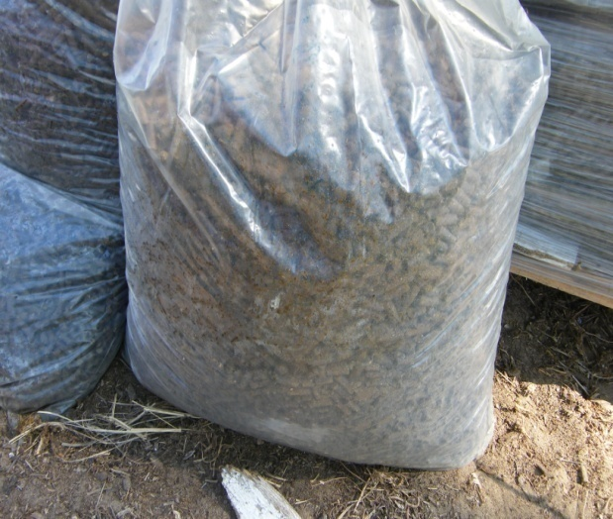
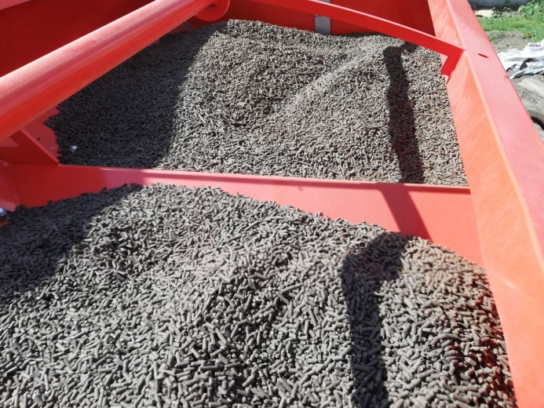
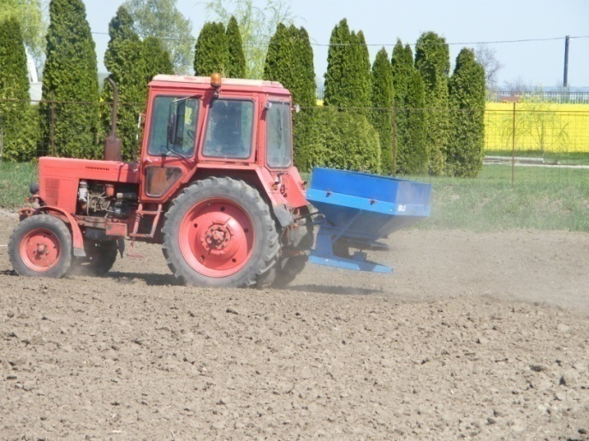
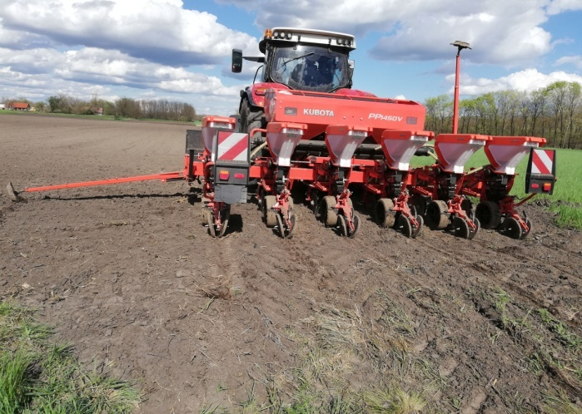
Milestones for precision organic fertilisation development
1. Assessment of pelleted organic fertilizers: 2019-2020
2. Incorporation trials implemented: 2020-2021
3. Arable crop cultivation experiments implemented: 2020-2022
Precision organic fertilisation – water retention technologies application: 2019-2023

Slide 5
Aim of precision organic fertilisation
Precision organic fertilisation of arable crops at the same pass of sowing.
Incorporation of pelletized organic fertilisers and soil conditioning products close to seedbeds at farm level.

Slide 6
Input material selection – agricultural biogas digestate
Solid phase separated digestate can reach 20 % of dry matter.
Digestates have high agronomic value in particular phosphorus content represents high level in solid phase.
Due to the entire anaerobic fermentation hygienic indicators reduce significantly.
Seed germination inhibitor compounds are successfully managed by controlled composting of solid phase digestate.
Surplus of heat energy and electricity as renewable energy sources is available in biogas plants for treatment, drying procedures.

Slide 7
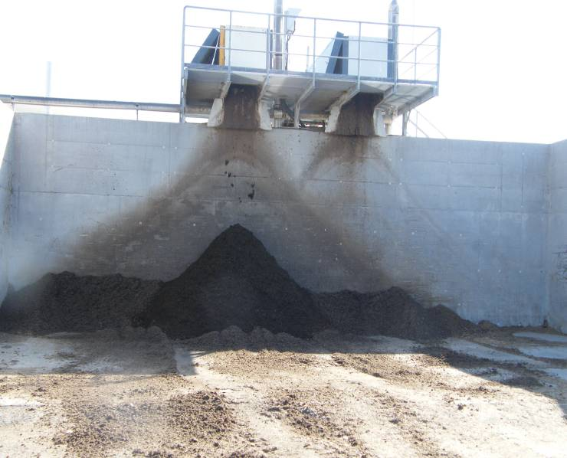
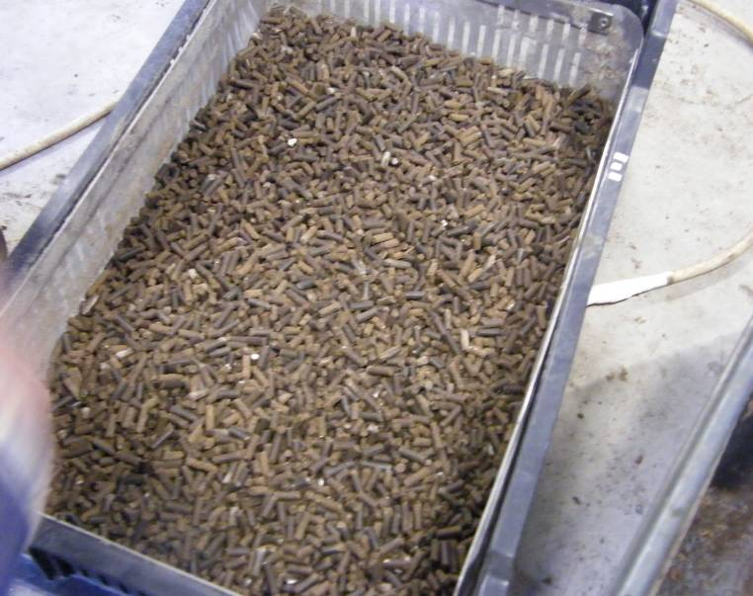



Processing of agricultural biogas digestate
  Solid phase recovery with screw press
  Dry matter: at least 20 mass %
  Total organic matter:
  at least 50 mass % in dry matter
  Total organic carbon:
  at least 25 mass % in dry matter
Pelletized end-product
Durability index: at least 98 %
With 4*4 és 6*6 mm of pellet profile
  Durability index of pelleted organic
  Fertilisers are available on the market
  80,85-97,5 %
Notes:
7
7

Slide 8
Pelletized fertilisers are assessed by GRANOFARM Group
Fertilisers input material | Durability index (%)
Agricultural biogas digerstate with high straw content | 81,38
100 % of chicken manure | 97,52
Biogas digestate with coating agent | 97,47
Composted biogas digestate without coating | 94,03
Poultry manure | 88,53
Dried cow manure | 96,16
Coated and pelleted poultry manure | 89,19
Pelletted animal byproduct | 93,88
Composted and pelleted biogas digestate | 93,00

Slide 9
Durability of fertilisers are available on the market
Product | Durability (%)
Pelleted cow manure | 97,43
1-2 mm diamater of pelleted poultry manure | 50,15
2-5 mm diamater of pelleted poultry manure | 80,84
Soil conditioning product 1 | 94,03
Soil conditioning product 2 | 88,53
Soil conditioning product 3 | 96,16
Based on the results it is concluded that durability index of pelletized fertilisers ranged between 50 and 98 Du % .

Slide 10
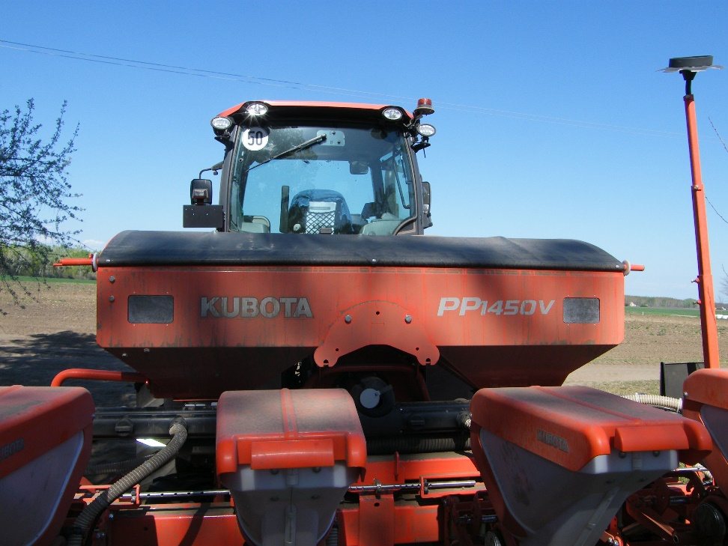
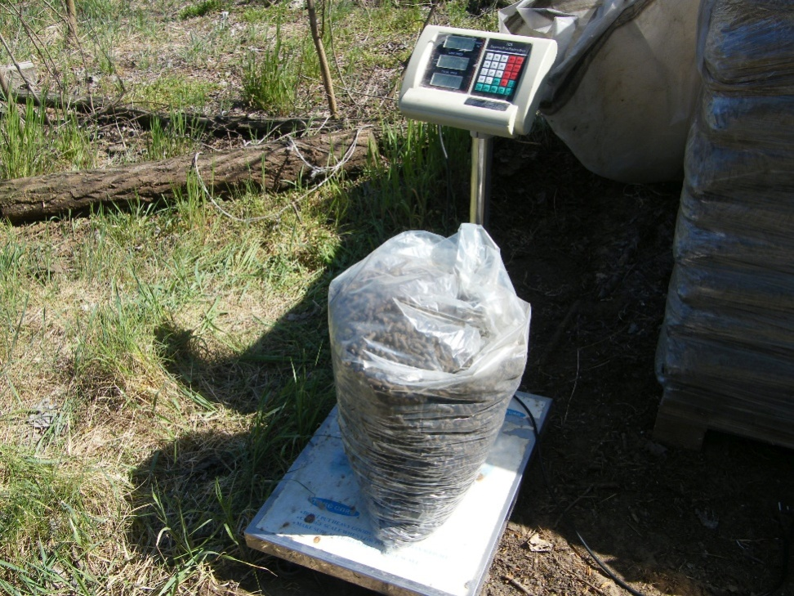
Incorporation test of pelletized fertilisers
Incoparotation test was implemented with precision drills (6 lines) 2020
Weighting input and output materials during the incorporation test, 2020

Slide 11
Disciplines for precision fertilisation at the same pass of sowing
3-4 mm of pellet diameter is acceptable
Pellets with 4*4 and 6*6 mm profile are recommended.
Density of pelletized fertilisers is around 0,55-0,6 t/m³ that means significantly lower parameter compared to inorganic fertilisers.
To increase volume of pellet tank is a key issue in precision fertilisation.
Optimizing dosage settings is necessary for effective application.

Slide 12
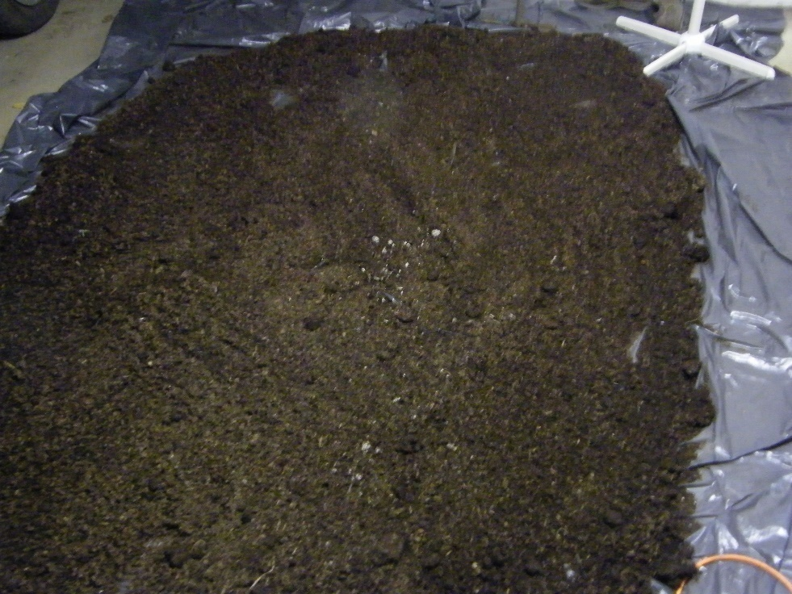
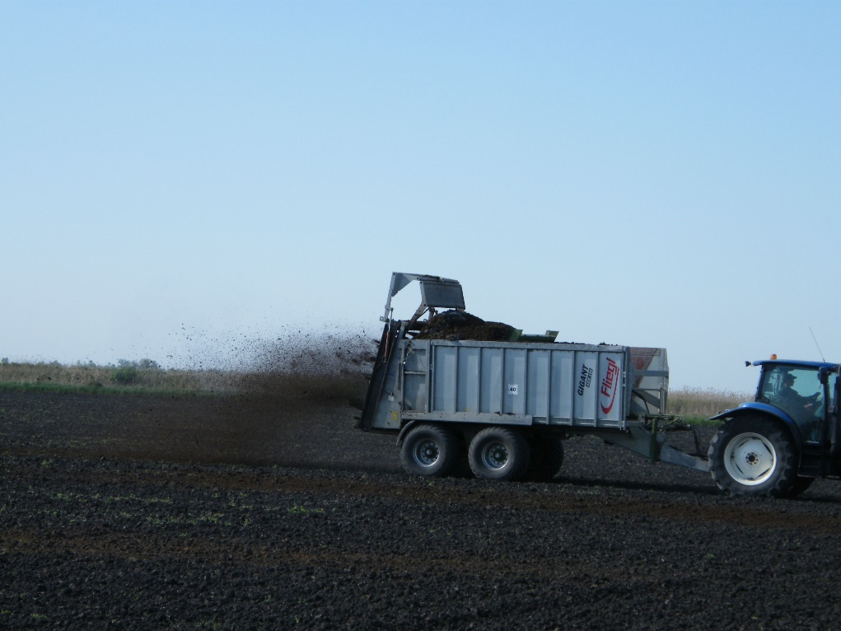
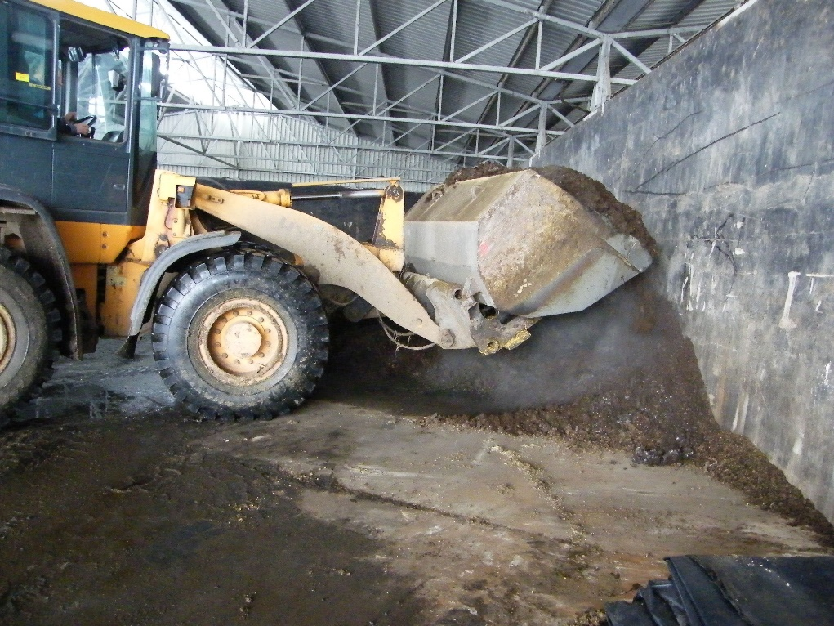
Basal fertilisation with composted biogas digestate, 2020-2022

Slide 13
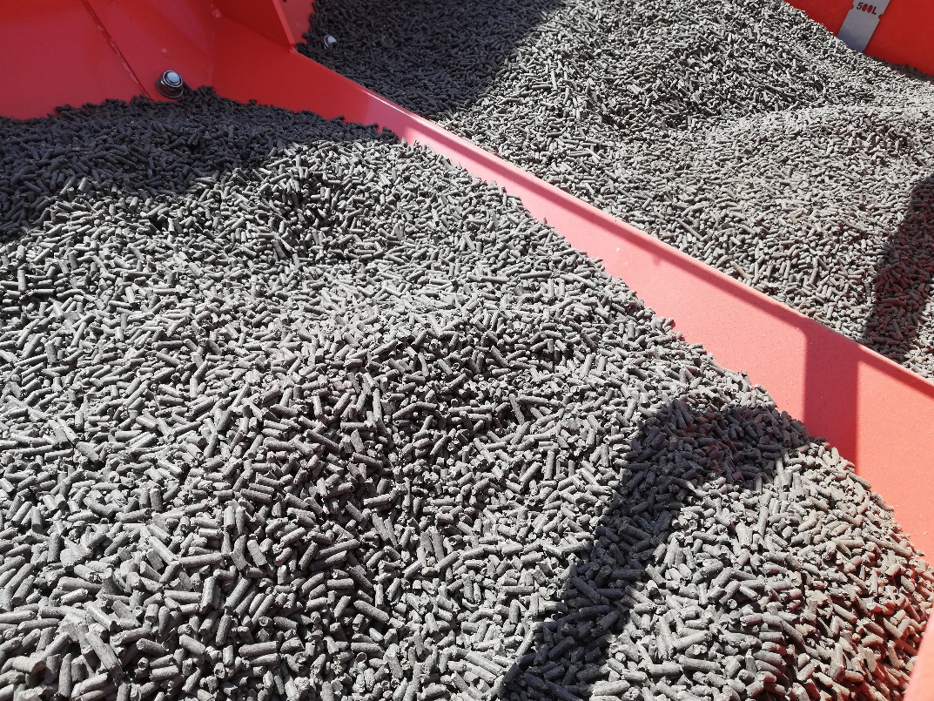
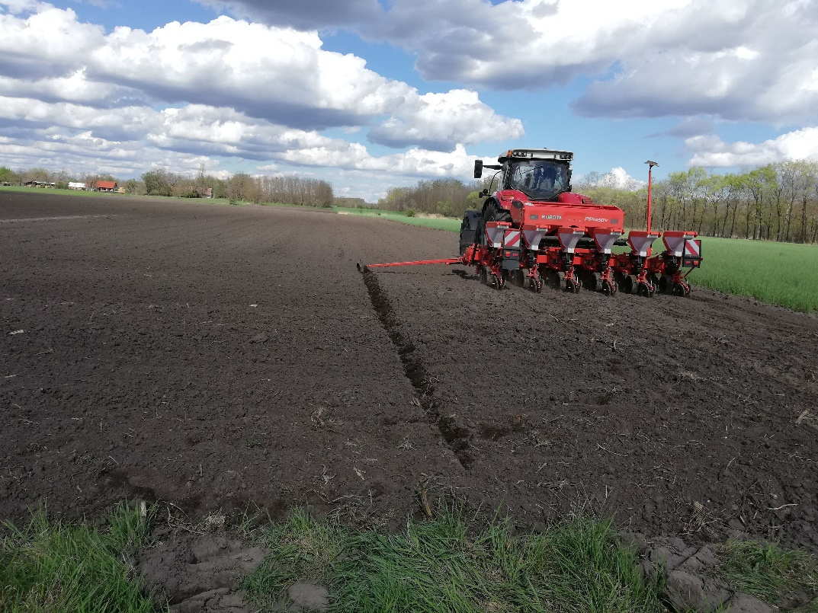
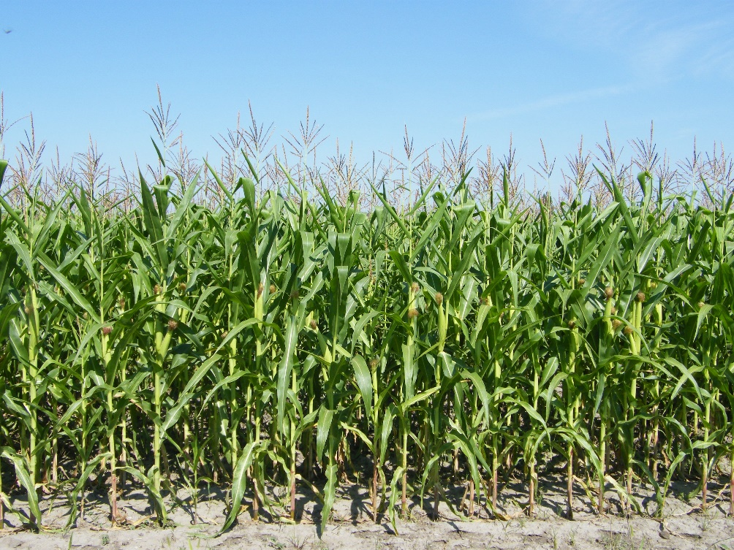
Pelletized organic fertiliser use at the same pass of sowing, 2021-2022

Slide 14
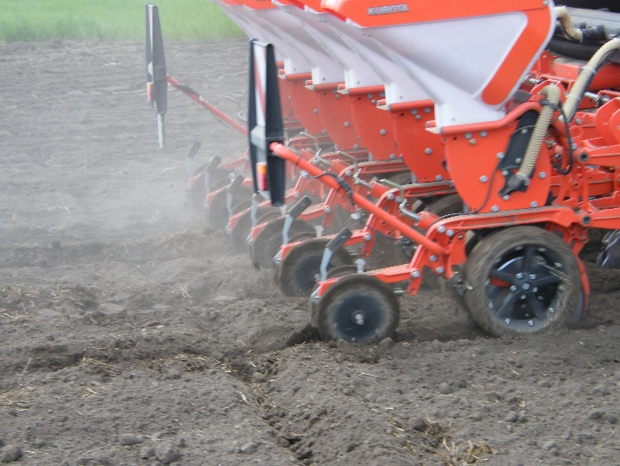
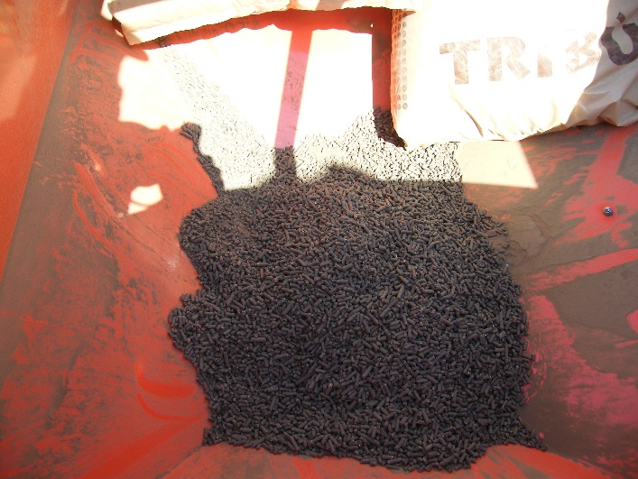
Practical aspects of pelletized organic fertilisers application at the same pass of sowing
Precision drills pellet container
Average density of pelletized organic fertilisers: 500-550 kg/m³
Preferably with a fertilizer tank with a capacity of at least 3,000 litre.
Application, dosage: maximum 300 kg/ha, directly to the seed bed.
Control on fertiliser incorporation is a key issue that needs to be tested before sowing at farm level.

Slide 15
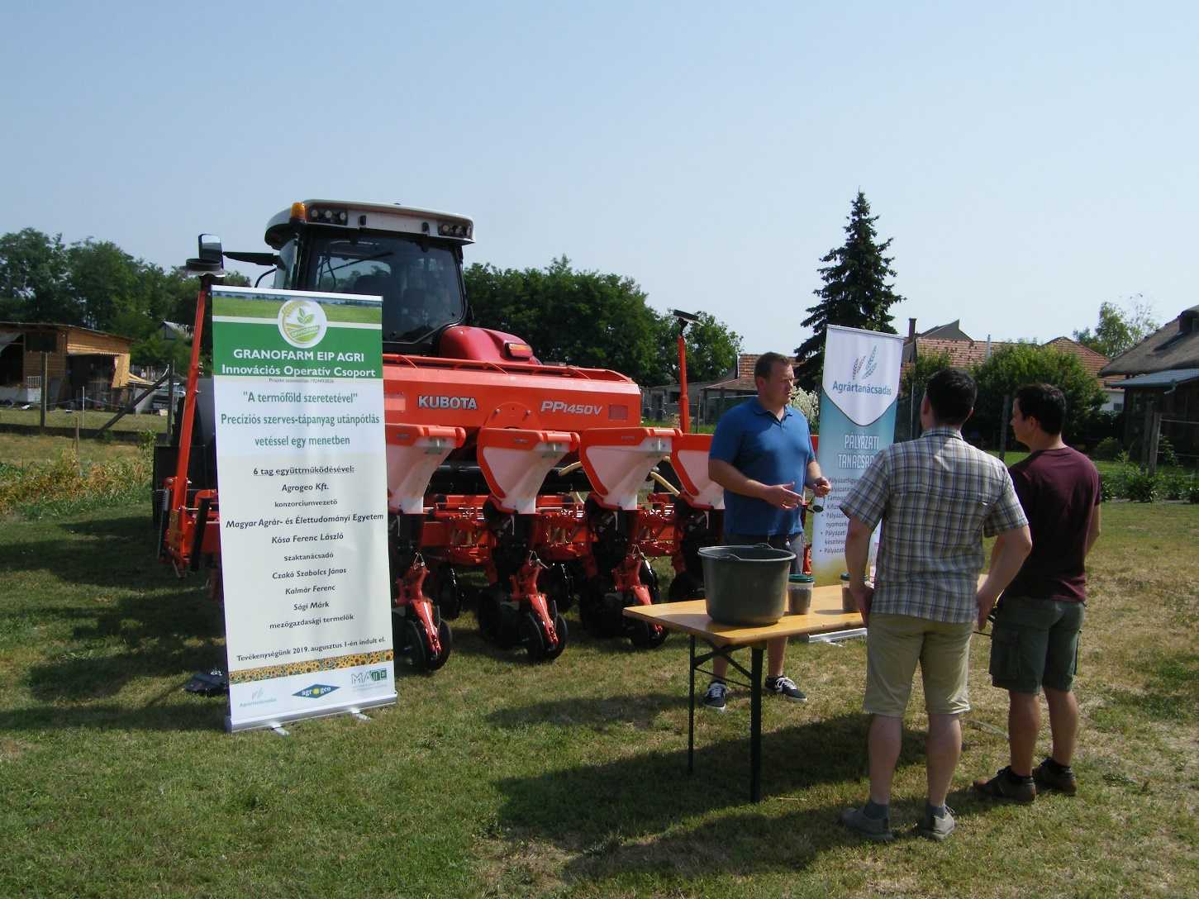
Dissemination activity of GRANOFARM Group
Site visit,
July 13, 2021

Slide 16
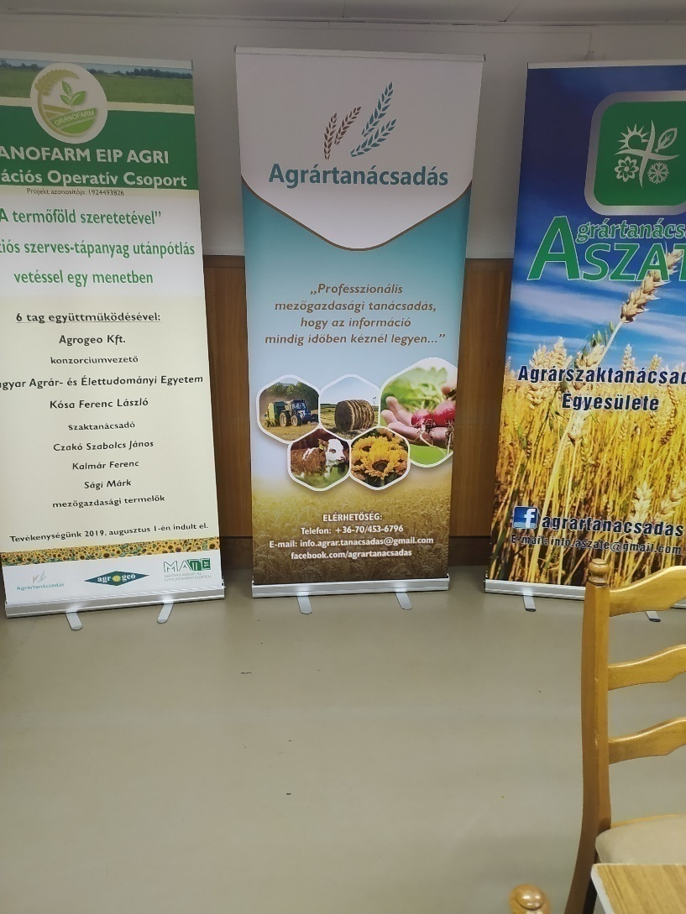
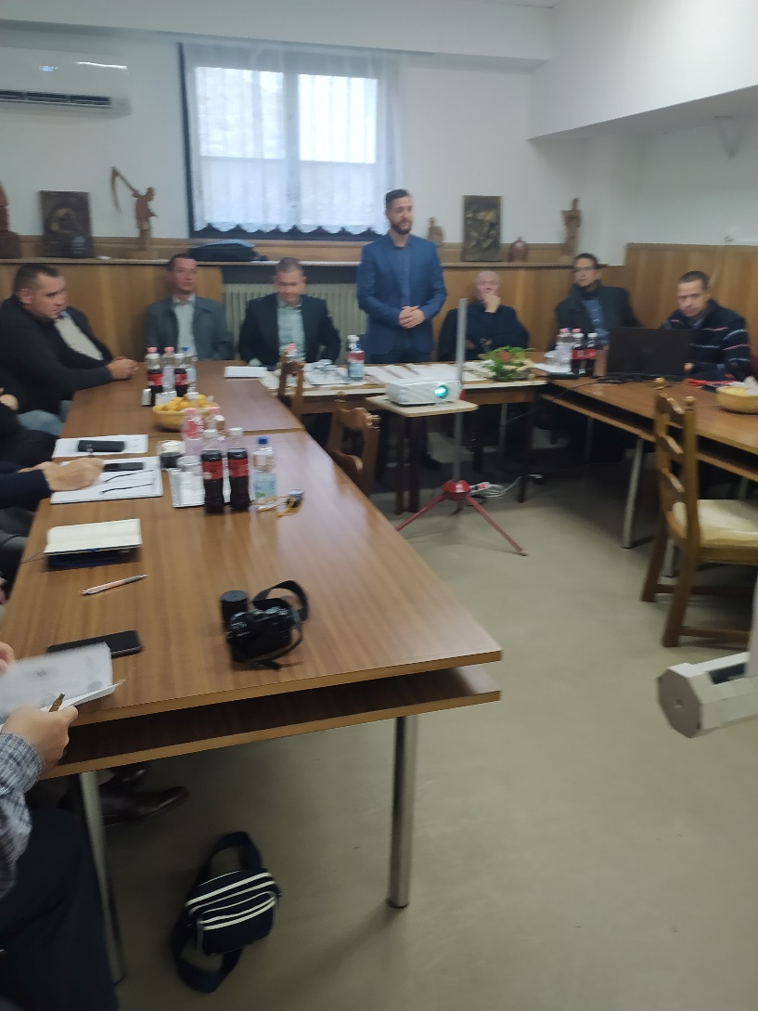
Dissemination activity of GRANOFARM Group
Workshop in Kecskemét , December 2, 2022

Slide 17
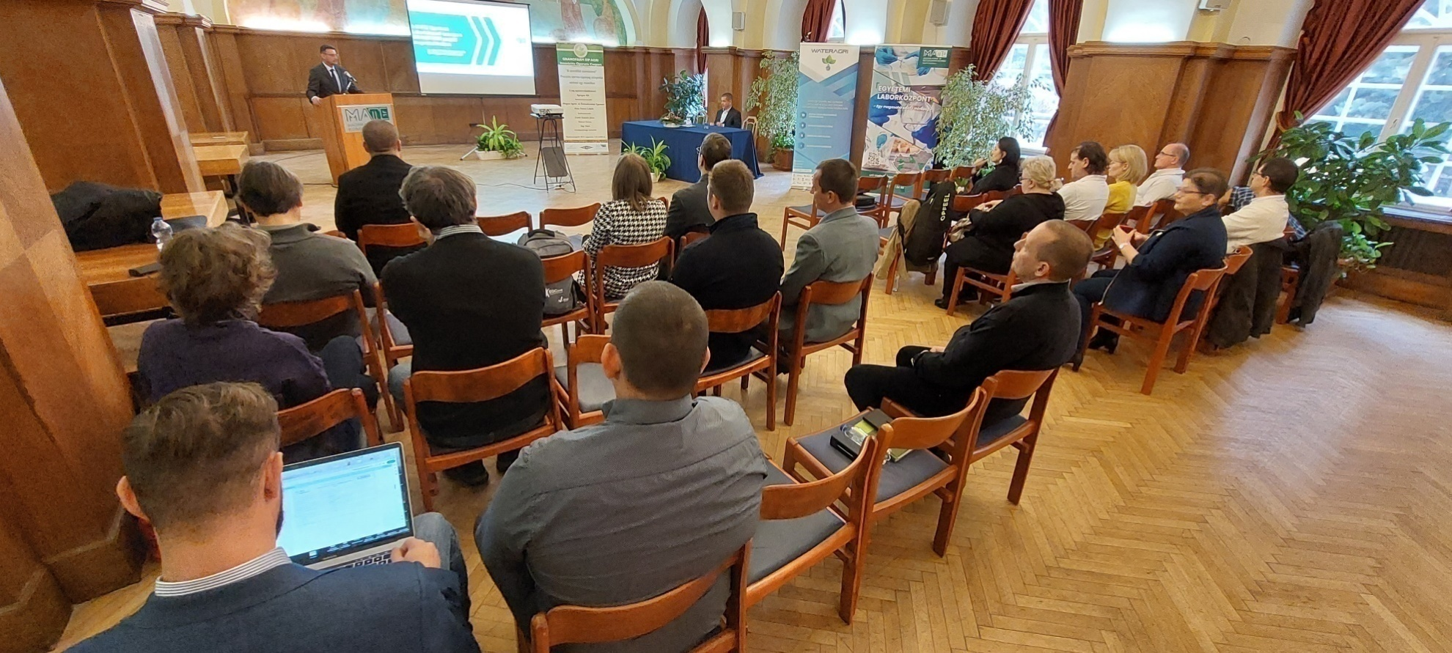
Dissemination activity of GRANOFARM Group
Project closuring event in Gödöllő, Hungarian University of Agriculture and Life Sciences,
December 6, 2023

Slide 18
Dissemination activity of GRANOFARM Group
Registration in technology transfer databases
Profile is available in Enterprise Europe Network database,
The Enterprise Europe Network (EEN) helps businesses innovate and grow on an international scale. It is the world’s largest support network for small and medium-sized enterprises (SMEs) with international ambition
In i2CONNECT project database GRANOFARM profile is available.
i2connect project team is working to fuel the competencies of advisors and their organisations to engage and support farmers and foresters in interactive innovation processes.

Slide 19
Contact
Tamás Szolnoky Managing Director, Agrogeo Ltd.
Phone: +36 70-279-4747
E-mail: agrogeo@mail.opticon.hu
Web: www.agrogeo.hu
Facebook: https://www.facebook.com/agrogeokft/

